Slide 1
ORMA
ORMA
ARQ
ARQ

Slide 2
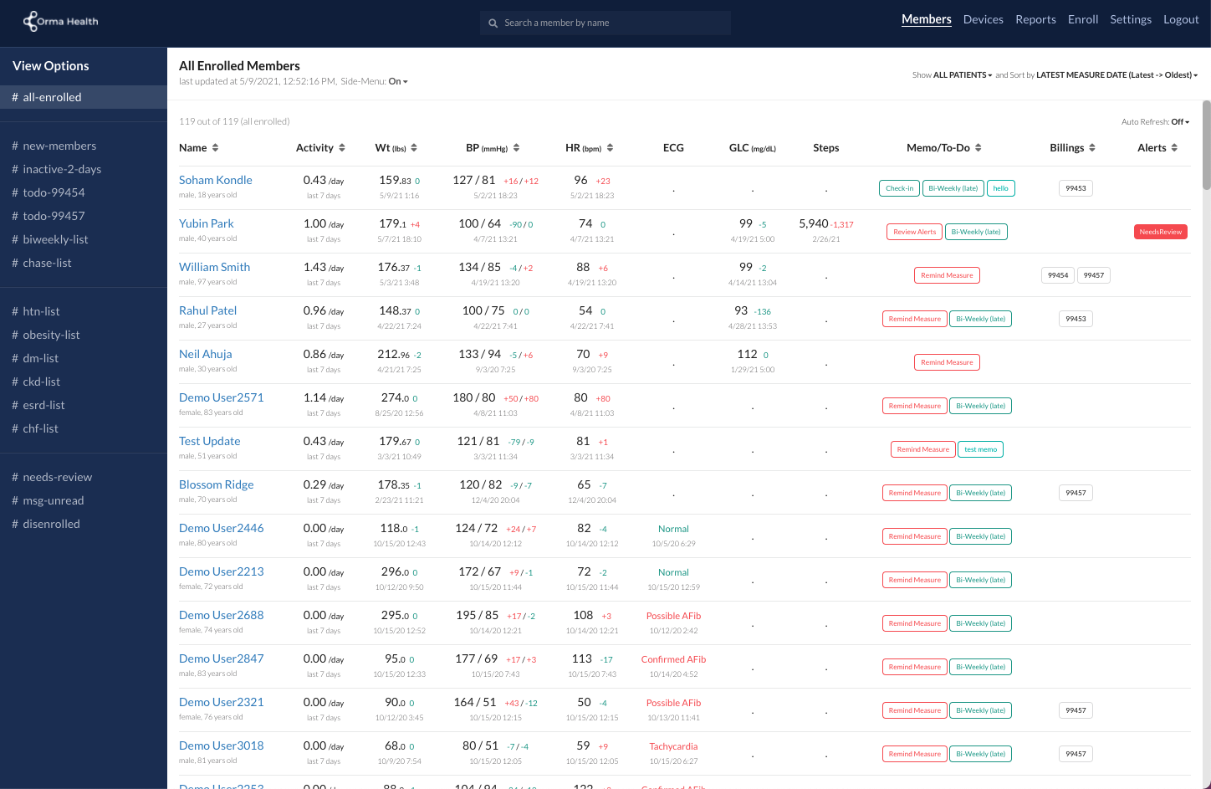

Slide 3
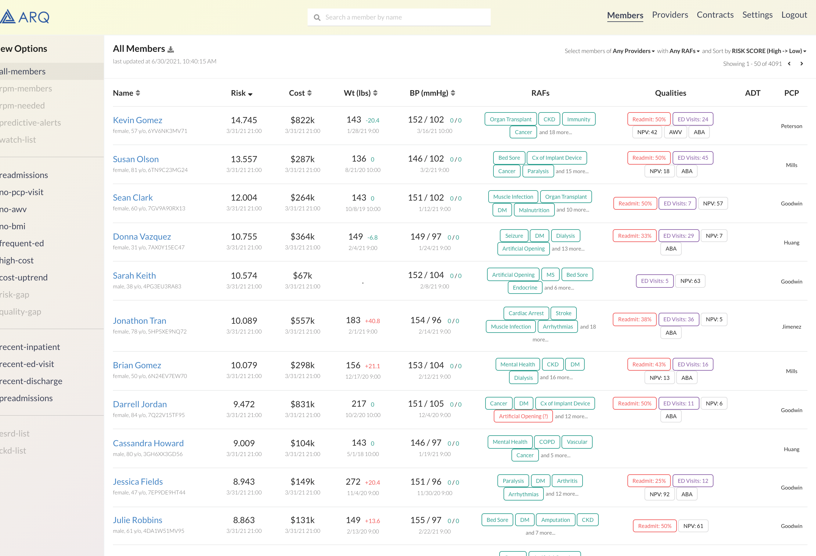

Slide 4
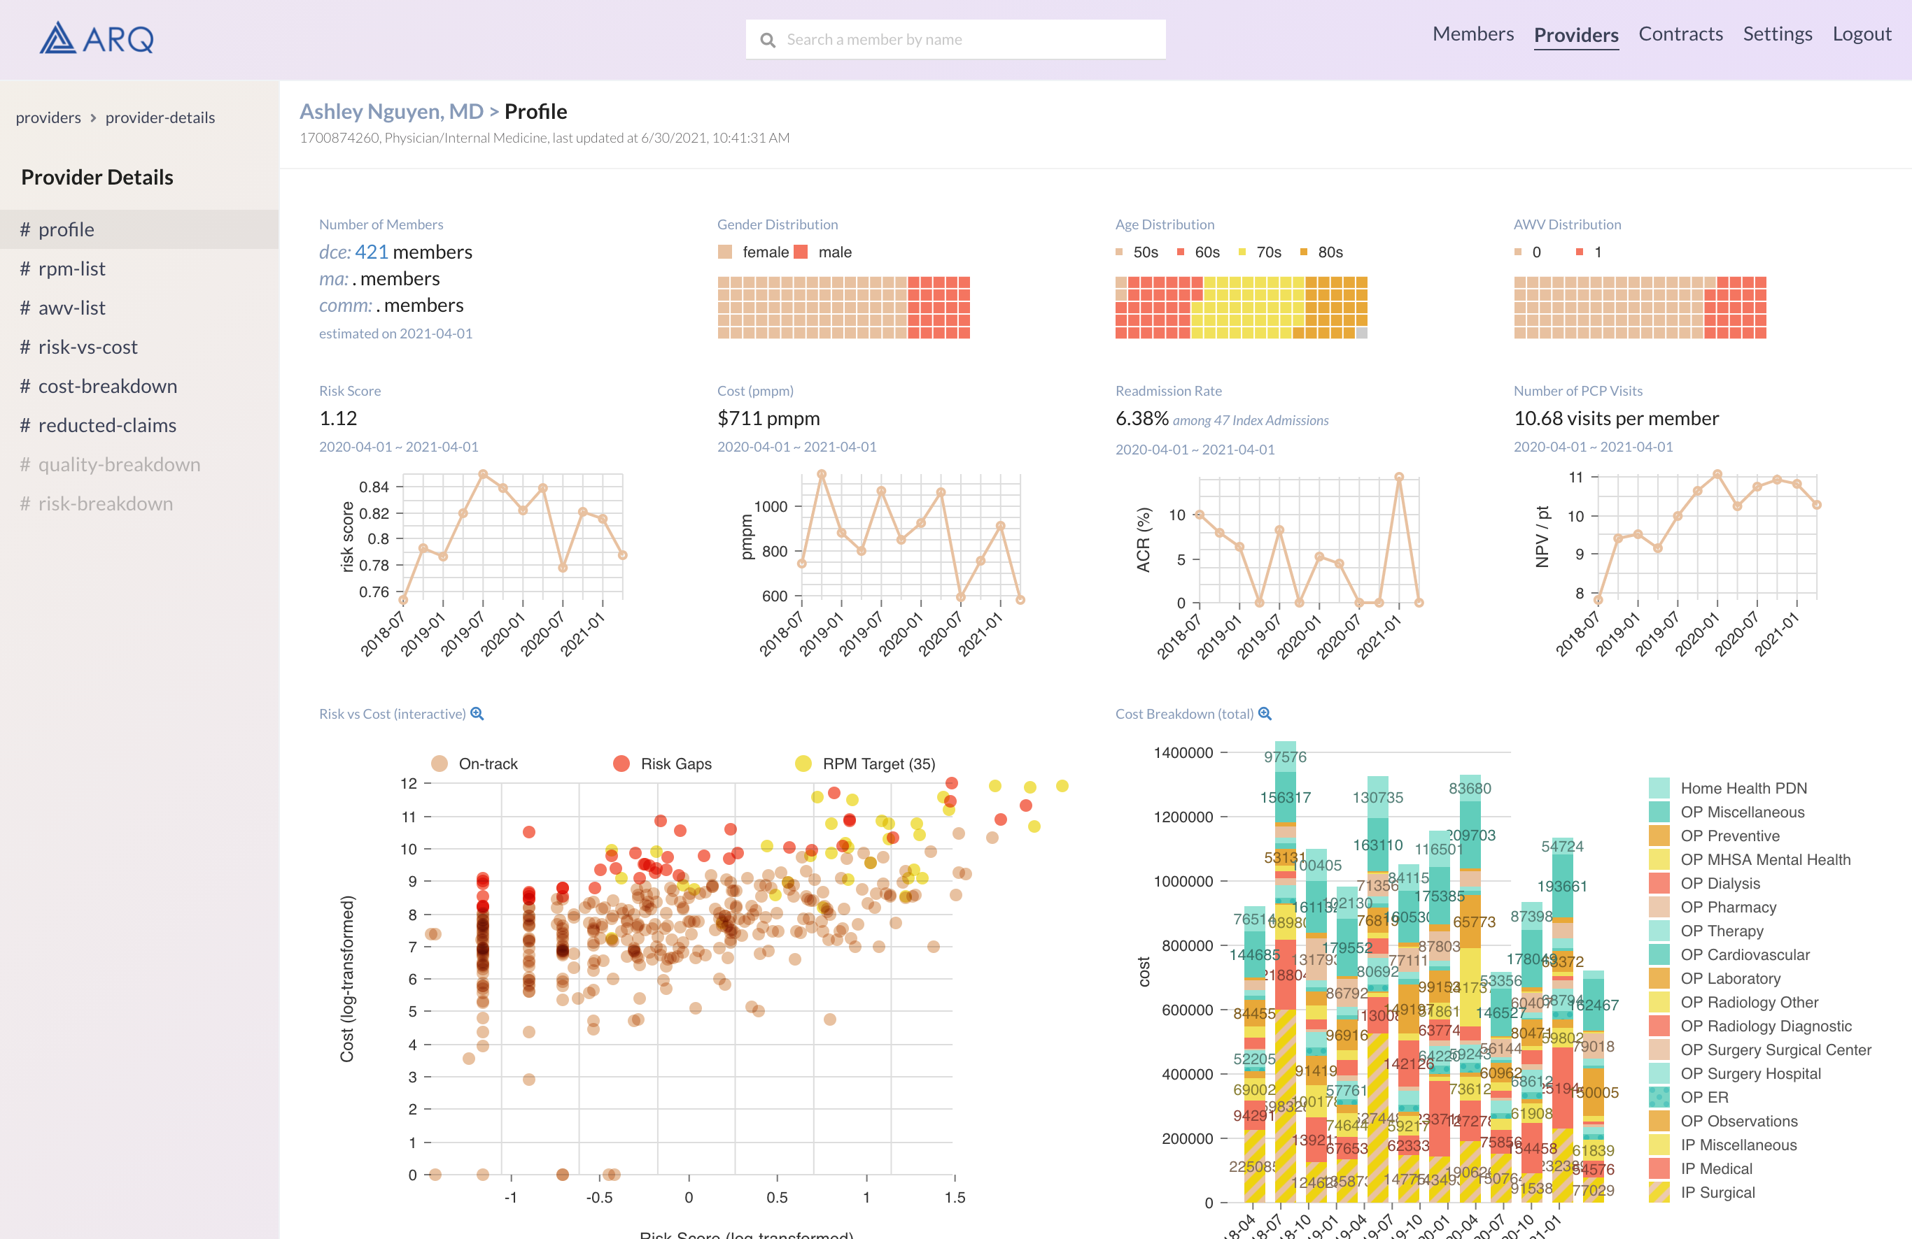

Slide 5
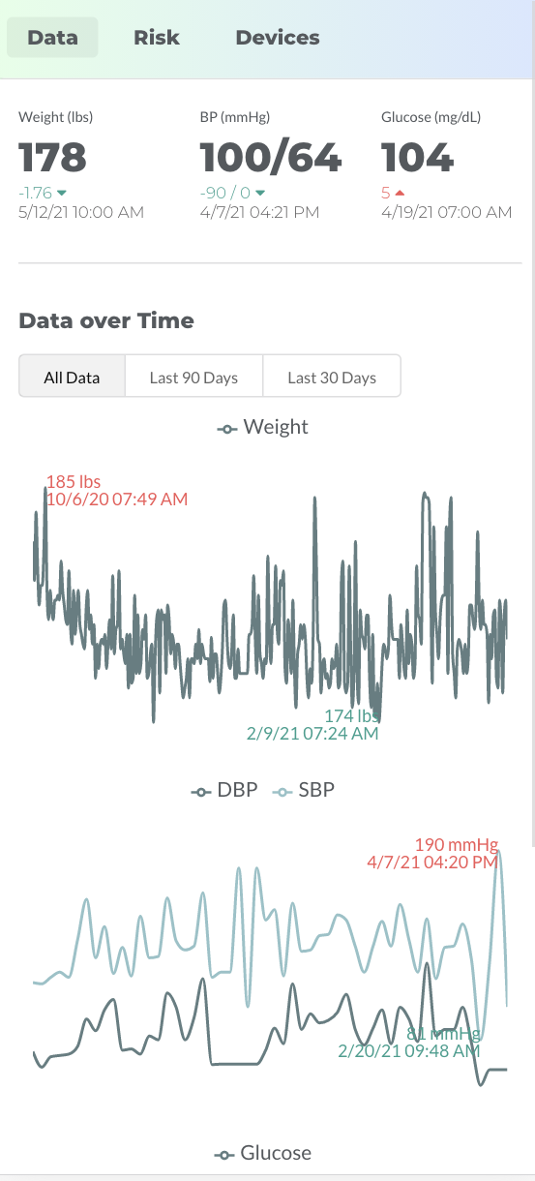

Slide 6

Claim and Claim Line Feed
Weekly Claim Reduction File
Provider Alignment Report
Beneficiary Alignment Report

Slide 7





